Slide 1


Presented by Sairaj Jadhav
IT Ticket Analysis

Slide 2

Introduction to results analysis
The agenda focuses on a detailed analysis of 97,499 cases resolved by 50 agents from 2016 to 2020, providing insights to guide future investments in IT service desk operations. It includes a comprehensive evaluation of ticket categories, satisfaction rates, and resolution times, along with a comparative study of key performance metrics. An interactive dashboard will be showcased to monitor agent performance and overall progress, accompanied by actionable recommendations to optimize IT service desk efficiency and improve operational outcomes.

Slide 3

Methodology used in the analysis
Corrected blank values and standardized number formats in the dataset.
Renamed column "Fetcha" to "Resolution Date" for better clarity and analysis.
Applied string, aggregate functions, sorting, filtering, and VLOOKUP for insightful data analysis.
Created pivots and charts for Agent ID vs Ticket Count, Satisfaction Rate vs Resolution Time, Categorical Ticket Distribution, and Agent Performance trends.

Slide 4
Comprehensive Ticket
Overview
Critical Insights from
Ticket Resolution Data
Total Tickets Resolved
A substantial total of
97,499 tickets were resolved by 50 IT Agents over 5 Years of time.
Analysis Time Frame
The dataset covers a significant time span from 2016 to 2020, enabling historical performance analysis.
Key Ticket Attributes
The tickets include 10 essential attributes such as Satisfaction Rate and Resolution Time for detailed insights.
Agent Performance Metrics
The dataset includes 6 specific agent data attributes for a thorough performance evaluation.
Data Quality Assurance
High data quality is ensured with no blank values and standardized formats, facilitating effective analysis.

Slide 5

Charts and Insights :
Satisfaction Rate Vs Years
Resolution Time Over Years
Ticket Count Vs Years
Distribution as per Satisfaction Rate
Distribution as per Resolution Days
Age Group Vs Satisfaction Rate & Resolution Time
Resolution Time By Resolution Category
Categorical Charts-
Severity
Request Category
Priority
Slicers -
Years, Age, Severity, Priority
and Request Category.

Slide 6

Lets start with the essential factors that determine and help us understand performance of IT Agents over Years.

Slide 7
.
Ticket Count Vs Years
Insights-
The ticket count nearly doubled from 13,051 in 2016 to 29,088 in 2020, indicating a substantial increase in demand for IT services.
The sharpest rise in ticket volume occurred between 2019 (21,490) and 2020 (29,088), suggesting either a significant increase in IT system usage or recurring issues.
The consistent rise highlights a need for scaling IT service resources to meet growing demands.

Slide 8
Satisfaction Rate Vs Years
Insights-
The satisfaction rate has shown a steady upward trend, improving from 3.98 in 2016 to 4.16 in 2020, indicating continuous enhancements in service quality.
The largest year-on-year improvement occurred between 2017 (4.07) and 2018 (4.09), suggesting successful initiatives during this period.
A marginal improvement from 2019 to 2020 (4.12 to 4.16) suggests a plateauing of satisfaction rates, indicating room for further innovation to boost user experience.

Slide 9
.
Resolution Time Over Years
Insights-
Resolution times remained relatively stable over the years, ranging between 4.52 and 4.59 days, with a slight increase in 2020 (4.59), suggesting increasing ticket complexity.
The lowest resolution time of 4.52 days was recorded in 2019, indicating peak operational efficiency during this year.
Despite a higher workload (as seen in ticket count), resolution time has not significantly degraded over the years, reflecting consistent performance under pressure

Slide 10
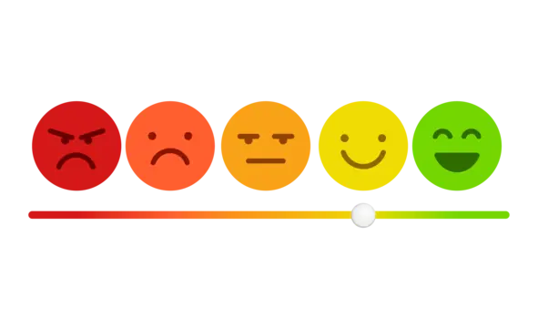

Understanding Insights about Satisfaction Rate and Resolution Time

Slide 11
Distribution as per Satisfaction Rate
Insights-
Most tickets (50,770) received a satisfaction rating of 5, demonstrating exceptional service quality for the majority of users.
A small fraction of tickets (1,977) received the lowest satisfaction rating (1), suggesting that only a minimal percentage of users were dissatisfied.
Moderate satisfaction levels (ratings of 3 and 4) were observed in 27,562 tickets, signaling areas where service can be improved to push ratings higher.

Slide 12
Distribution as per
Resolution Days
Insights-
A significant portion of tickets (25,071) were resolved on the same day (0 days), highlighting strong operational efficiency for quick resolutions.
Tickets taking 1-2 days to resolve (9,277 and 6,466 respectively) form the second-largest group, suggesting that most tickets are resolved within short timelines.
The number of tickets decreases as resolution days increase, with the smallest group (4,850) taking 8 days, indicating focus on resolving older tickets.

Slide 13



Understanding Age Group Performance and Categorical Insights

Slide 14
Age Group Vs Satisfaction Rate and Resolution Time
Insights-
The age group 38-42 exhibited the highest satisfaction rate (4.59) and one of the lowest resolution times (4.05), showcasing efficient service delivery for this demographic.
The age group 48-52 had the lowest satisfaction rate (4.11) and slightly higher resolution times (4.20), indicating a potential area for improvement.
The age group 33-37 achieved the fastest resolution times (3.99 days), reflecting high efficiency in addressing tickets for this category.

Slide 15
Resolution Time by Request Category
Insights-
Login Access issues had the fastest resolution time (0.31 days), reflecting excellent efficiency in resolving authentication problems.
Hardware issues had the longest resolution time (7.63 days), suggesting a need to streamline processes for hardware-related problems.
Software and System issues had moderate resolution times (5.24 and 6.62 days, respectively), indicating areas where improvements can enhance service delivery.

Slide 16
.
Categorical Data
Efficient Resolution for Normal Severity Tickets: Most tickets (88,656 categorized as "Normal") are resolved quickly, with 25,071 resolved on the same day, showcasing operational efficiency for non-critical issues.
Dominance of Software-Related Requests: System issues (39,002 tickets) are the most frequent across categories, indicating a need for better system software maintenance and proactive troubleshooting.
Focus on Critical Cases: Normal tickets (88,656) and High-priority tickets (35,549) are maximum, reflecting need for effective prioritization as well as building a steady automation in normal request categories, but hardware-related issues may need optimization due to longer resolution times

Slide 17
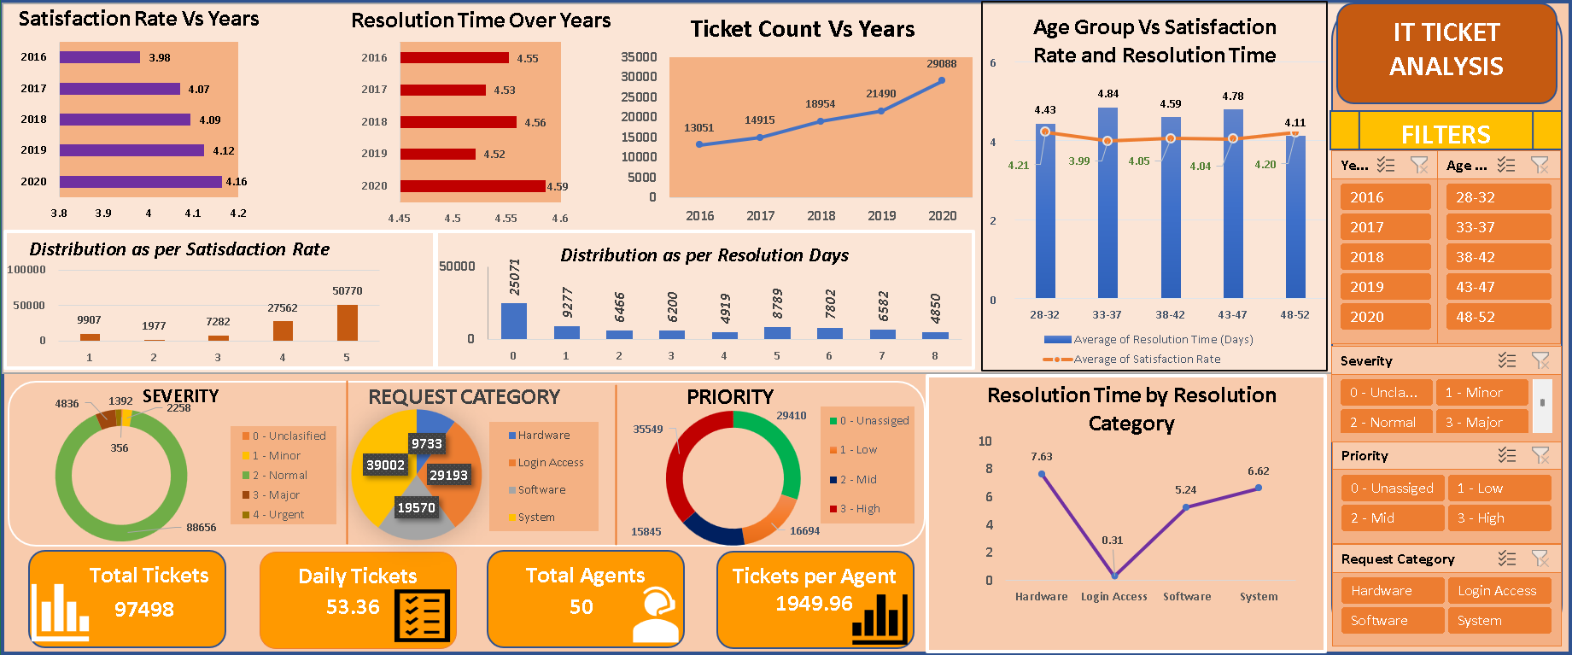
Dashboard and Visualization:
The dashboard analyzes IT agents' performance using key metrics like Average Satisfaction Rate and Average Resolution Time.
Slicers allow users to filter data by quarter, year, age group, and category.
It offers insights into agents' effectiveness and efficiency over time.
The dashboard helps assess performance trends and identify areas for improvement.

Slide 18

External and internal challenges
Internal Challenges:
Increasing resolution times for hardware-related issues, highlighting inefficiencies in internal processes.
Limited satisfaction rates for the 48-52 age group, indicating gaps in service personalization or communication.
External Challenges:
Growing ticket volume year-on-year, driven by increased IT service demand, putting pressure on resources.
Dominance of software-related requests, requiring constant updates and proactive maintenance to prevent recurring issues.

Slide 19





Recommendations:
Analyze Trends: Monitor ticket patterns, prioritize recurring issues, and use predictive analytics for proactive solutions.
Focus on Quality: Prioritize effective resolutions over speed, track quality metrics like FCR and CSAT, and equip agents with proper resources.
Gather Feedback: Collect user feedback post-resolution, use surveys or NPS, and update processes based on insights.
Support Agents: Provide training, recognize achievements, balance workloads, and ensure a positive work environment.
Automate Processes: Use tools for ticket categorization, chatbots for FAQs, and optimize workflows for efficiency.

Slide 20

Conclusion and Acknowledgements
Key Insights and Future Directions
Key Insights from IT Ticket Analysis
The analysis identifies critical areas for improvement in service delivery.
Actionable Insights Derived
Targeted metrics provide actionable insights for enhancing service efficiency.
Foundation for Ongoing Discussions
This analysis serves as a foundation to evolve the IT ticketing system further.
Dataset Utilized
The analysis was based on the IT Ticket Analysis dataset.
Institutional Support
Conducted under the auspices of Newton School.
Mentorship Acknowledgement
Thanks to all mentors who guided this analysis process.

